Slide 1
Atelier sur l’outil « Thémis »
Workshop on the tool « Themis »
Suivi des approvisionnements responsables
Monitoring of sustainable procurements
ATIBT – LCB – PROBOS

Slide 2
Ordre du jour / Agenda
1. Retour d’expérience du suivi des approvisionnements de la fédération néerlandaise
Feedback from the monitoring of supplies of the Dutch federation
2. Présentation du portail de collecte de données - Thémis
Presentation of the data collection portal – Themis
3. Premiers résultats de l’enquête Thémis
First results
Résultats globaux de ATIBT / ATIBT global results
Résultats globaux de LCB / LCB global results
Q&R / Q&A
4. Atelier sur le calcul du score
Workshop on score calculation
Lien avec l’outil Thémis et la charte environnementale
Link with the Themis tool and the environmental charter

Slide 3
Retour d’expérience du suivi des approvisionnements de la fédération néerlandaise
Notes:
Pwerpoint de Mark

Slide 4
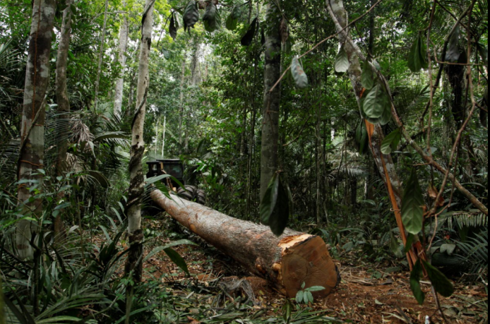
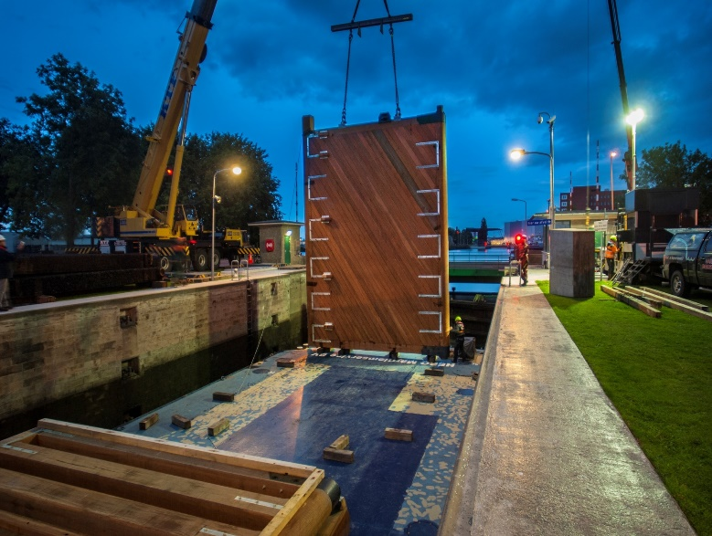
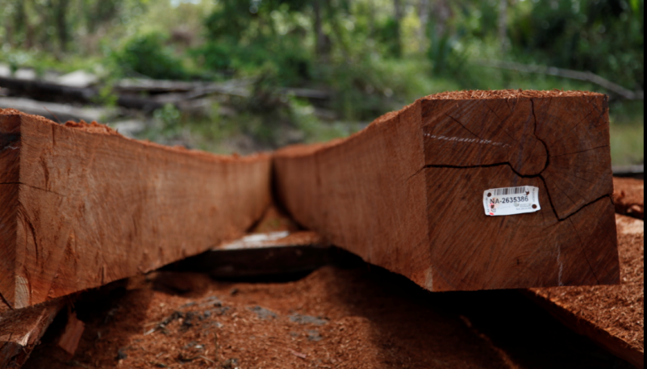
Lessons learned learned from the NLs Timber Trade Association
Mark van Benthem, Probos
Wijma Kampen BV

Slide 5
21 Reasons to Use Wood
Sustainable / Speed of construction / Precise / Quality Control / Lighter than masonry - concrete / Transportable - storable / Continuous work patterns / Mass not frame / Dry, clean, non-toxic / Simple site procedures / Good in a fire / Flexible - easily changed on site / Services integrated offsite / Structure can be the finish / Strong and durable but can be replaced if damaged / Warm - own thermal properties means less insulation / Interesting tactile-flat surfaces / Safe - non allergic & healthy to inhabit / Color - intrinsic colours, changed simply / Compatible with other materials / Has aura, smells great, embodies qualities of scale and time
Alex de Rijke, Director of dRMM
Notes:
Enough reasons to use sustainably sourced timber!

Slide 6
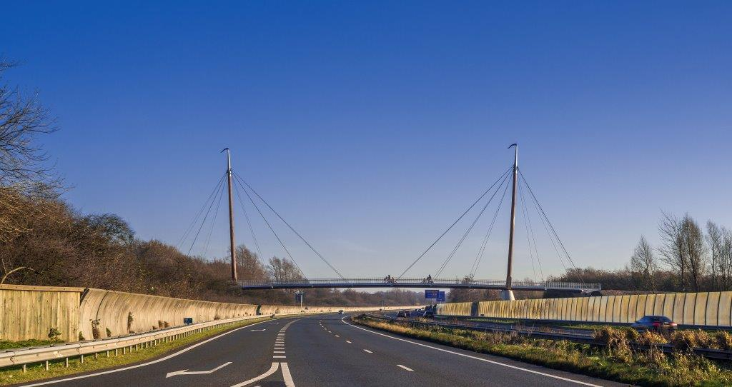
Ode to wood
Wijma Kampen BV

Slide 7
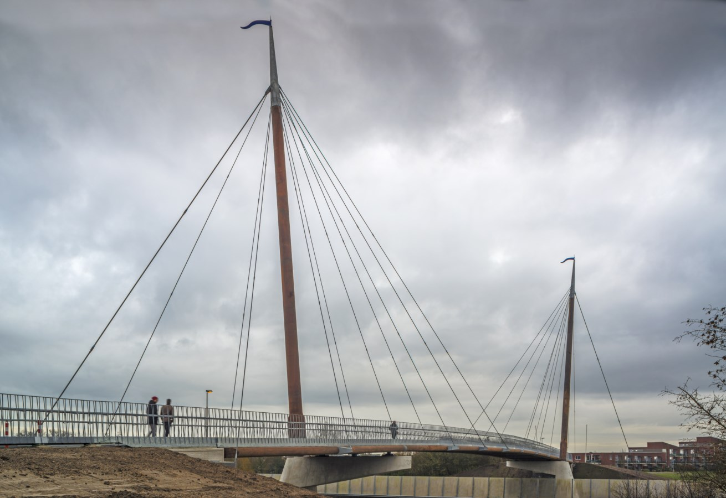
Wijma Kampen BV

Slide 8
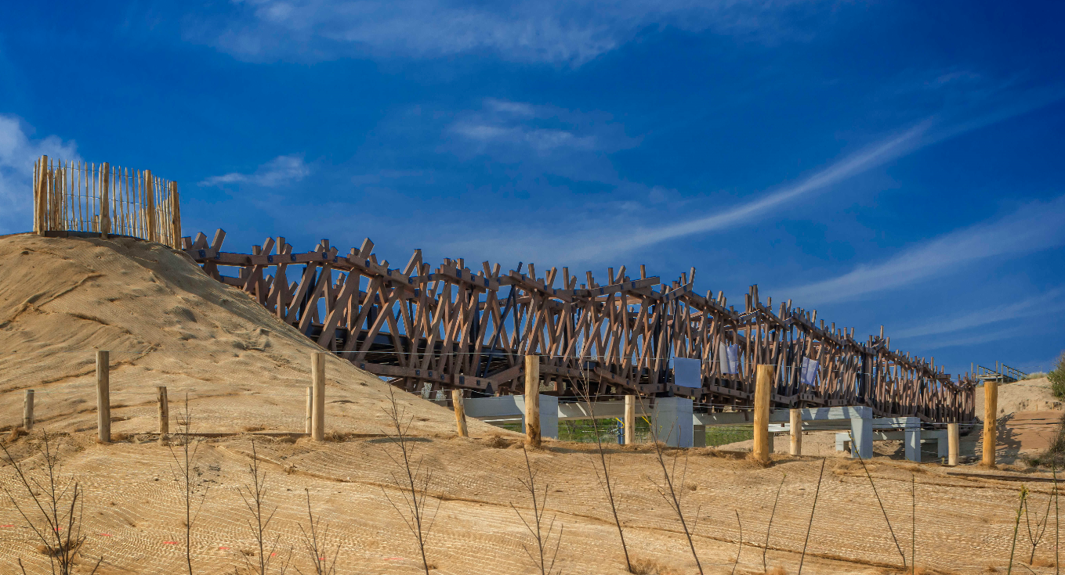
Wijma Kampen BV

Slide 9
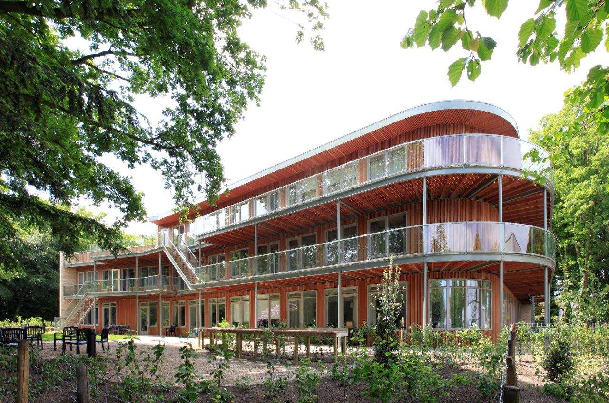
Van den Berg Hardhout BV

Slide 10
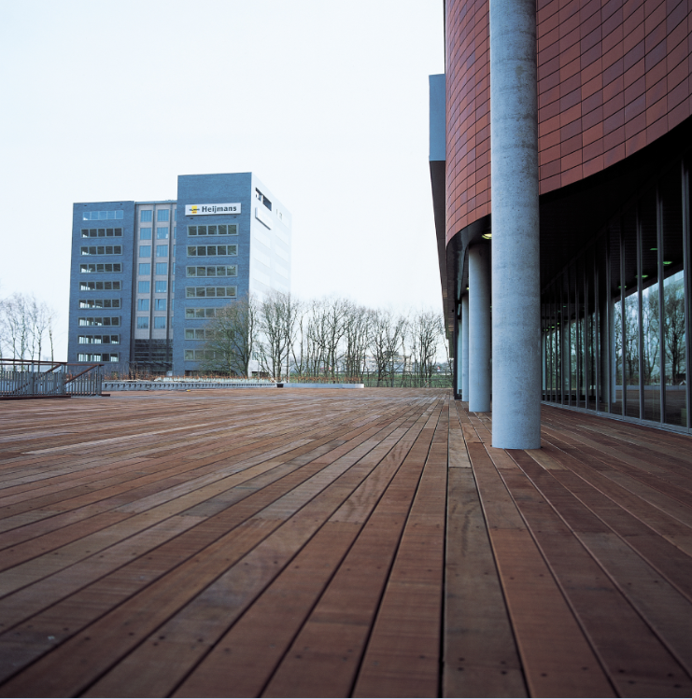
Precious Woods holding

Slide 11
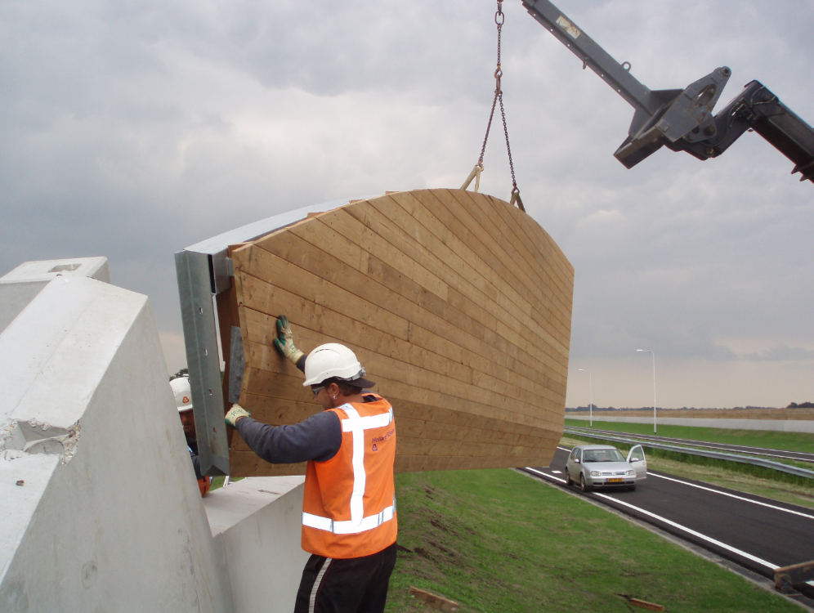
Houthandel RTT

Slide 12
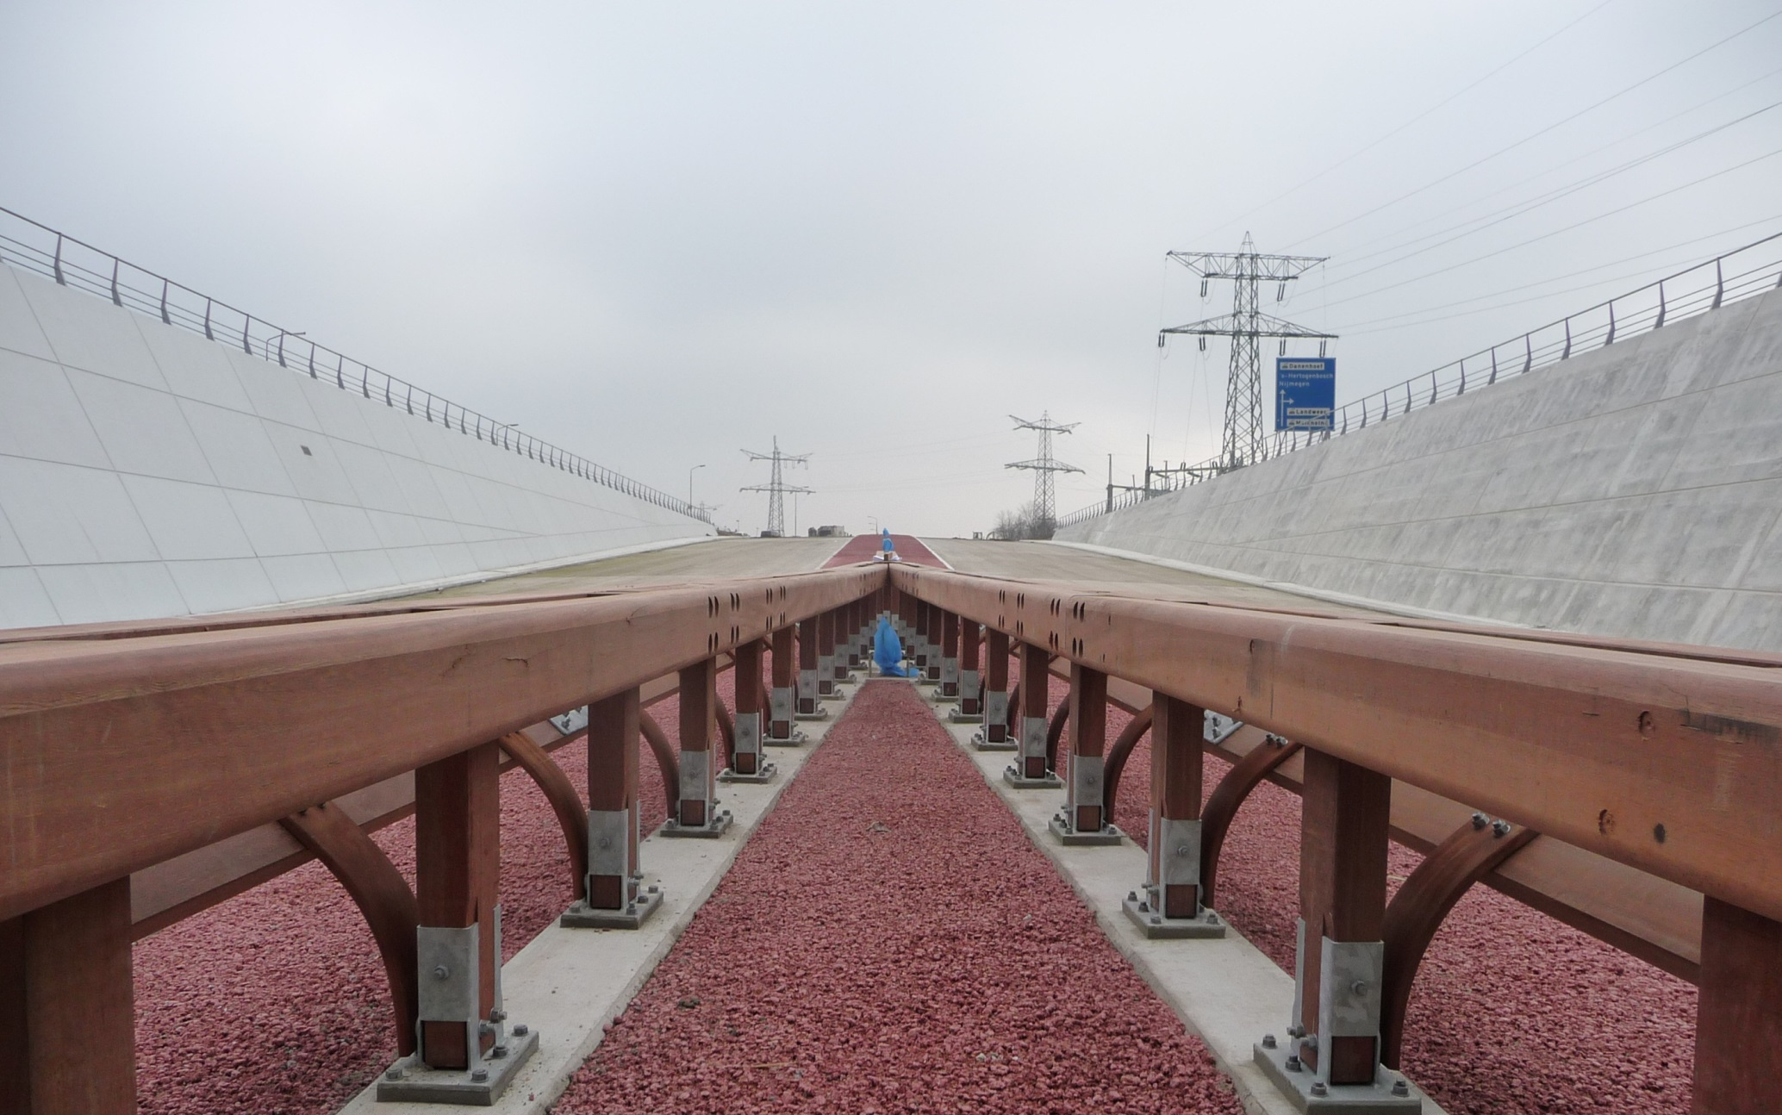
Wijma Kampen BV

Slide 13

Wijma Kampen BV

Slide 14
21 Reasons to Use Wood
Sustainable / Speed of construction / Precise / Quality Control / Lighter than masonry - concrete / Transportable - storable / Continuous work patterns / Mass not frame / Dry, clean, non-toxic / Simple site procedures / Good in a fire / Flexible - easily changed on site / Services integrated offsite / Structure can be the finish / Strong and durable but can be replaced if damaged / Warm - own thermal properties means less insulation / Interesting tactile-flat surfaces / Safe - non allergic & healthy to inhabit / Color - intrinsic colours, changed simply / Compatible with other materials / Has aura, smells great, embodies qualities of scale and time
Alex de Rijke, Director of dRMM
Notes:
Enough reasons to use sustainably sourced timber!

Slide 15
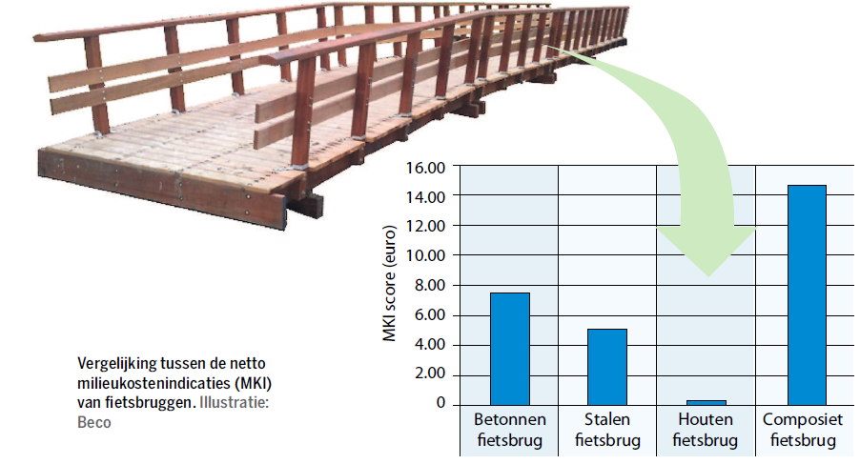
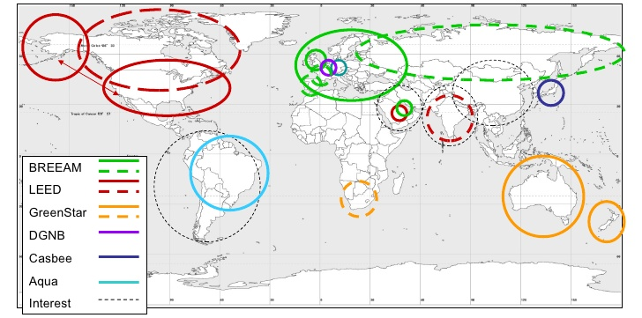

Increasingly scientific proof
Life Cycle Analyses (LCA)
Environmental Product Declaration (EPD)
Green Building assessment schemes

Slide 16
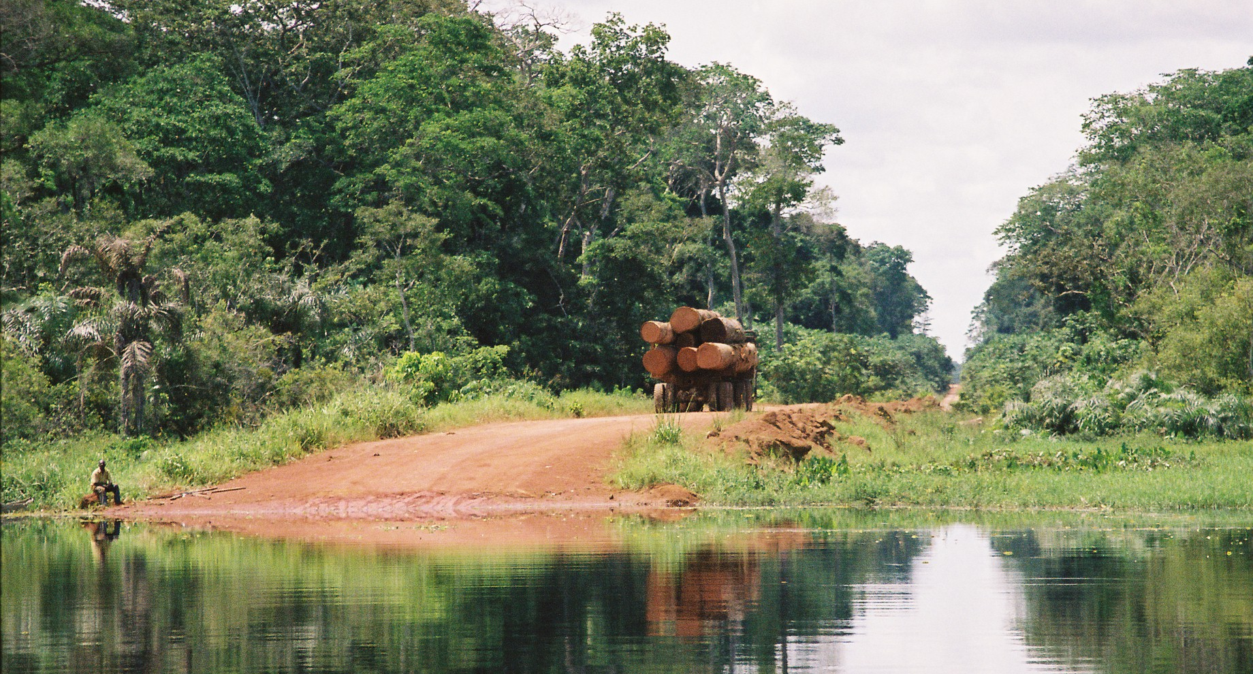
“Isn’t all wood sustainable?”
Mark van Benthem, Probos

Slide 17

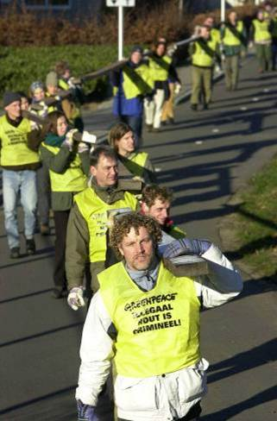




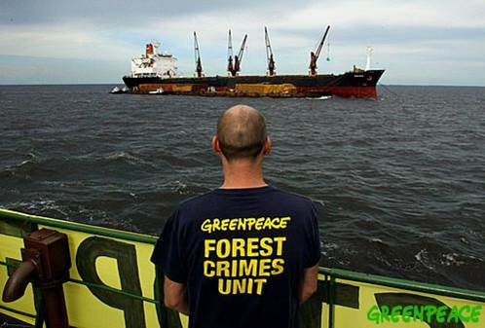

Notes:
With at the peak advertisements in national newspapers where the Dutch minister of Justice and the minister for the environment portrayed as criminals

Slide 18
NTTA response (I)
2003: code of conduct, a.o.:
  preference resp. sourced timb; sanction system
2003: 1st policy plan 2003 – 2005, a.o.:
  selfreporting (country of origin; lkts; volume RST; etc.) dialogue stakeholders; comms; csr
2006: 2nd policy plan 2006 – 2009, a.o.:
  Reflection 1st plan; target 75% RST in 2009:
    Softwood 100%; tropical 50%; temperate 25%; panels 75%

Slide 19
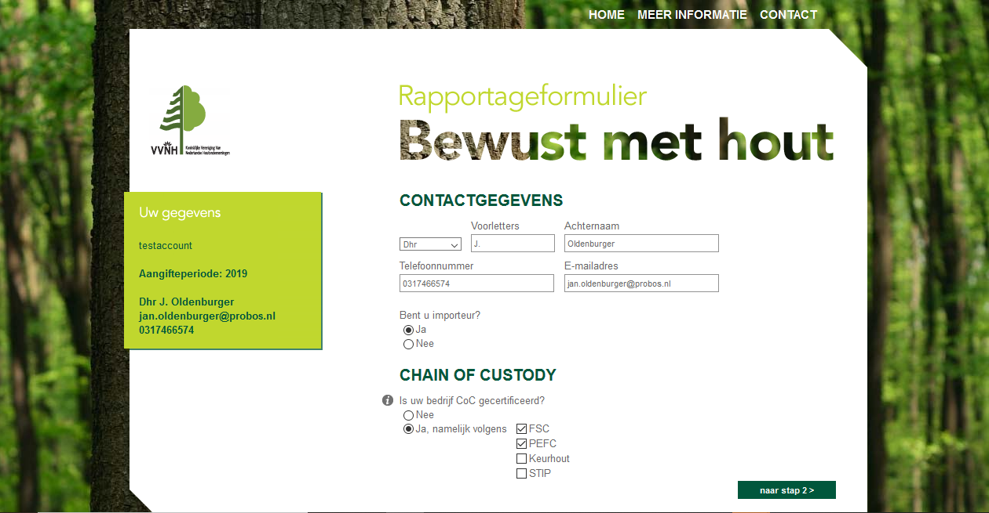
NTTA response (II)
2008: introduction reporting system +

Slide 20
NTTA response (II)
2008: introduction reporting system + transparancy

Slide 21
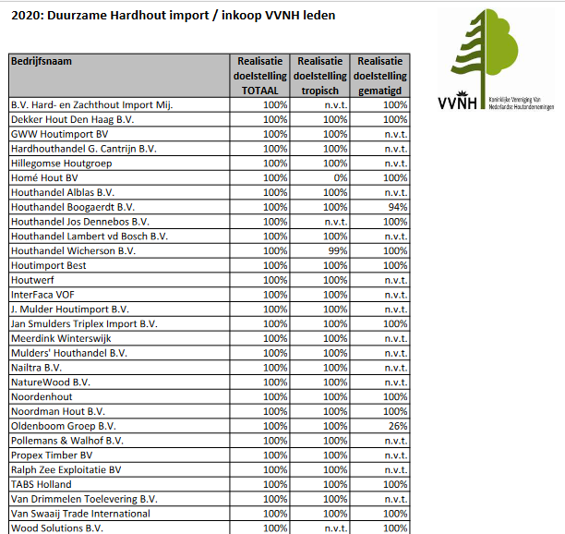
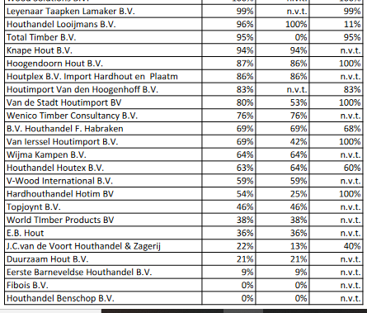
https://www.vvnh.nl/system/files/IndividuelePrestatie_Hardhout_0.pdf

Slide 22
NTTA response (III)
2010: 3rd policy plan 2010 - 2015, a.o.:
  Increased focus on public procurement
  Monitoring 2x per year
  New targets: 85% overall in 2015:
    50% hardwoods; 85% panels and 100% softwoods

Slide 23
NTTA response (IV)
2016: 4th policy plan 2016 – 2020, a.o.:
  Observation: fairly basic; RST is the norm.
  Spotlight on well performing companies
  Encouraging and appealing members lacking behind (sanctions)
  New targets: 90% overall in 2020:
    65% hardwoods; 90% panels and 100% softwoods

Slide 24
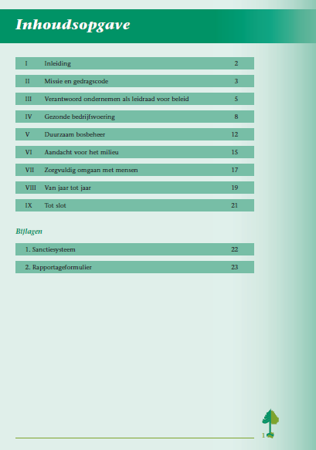
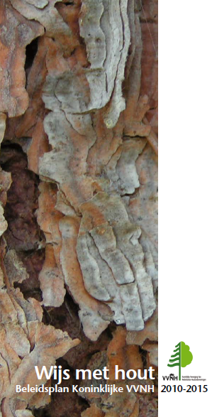
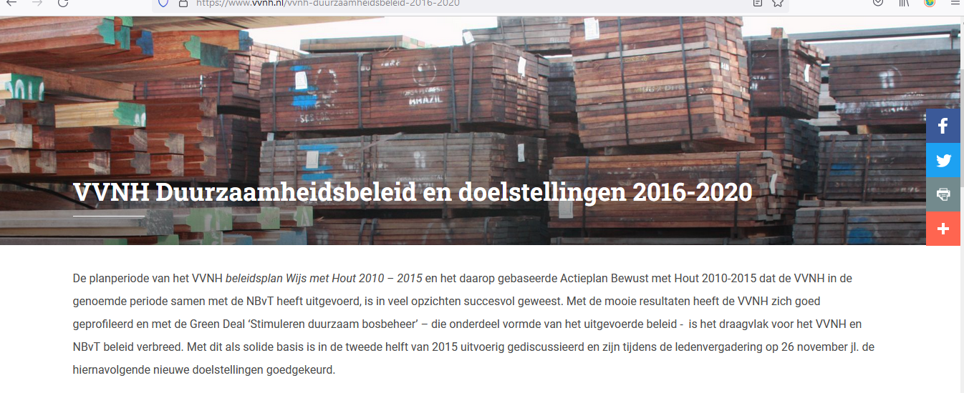
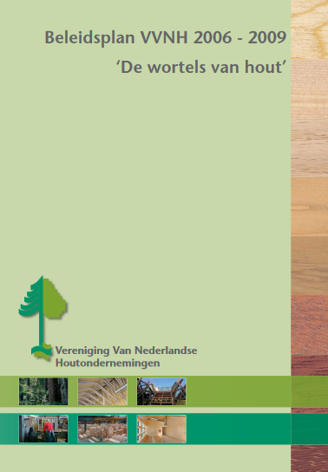

Slide 25
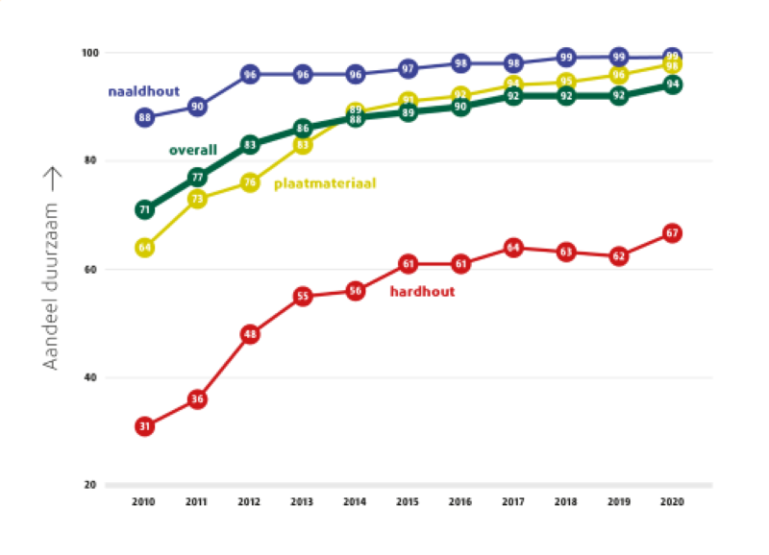
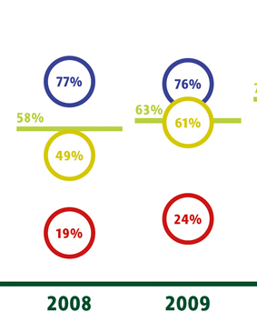
Many plans; results?

Slide 26
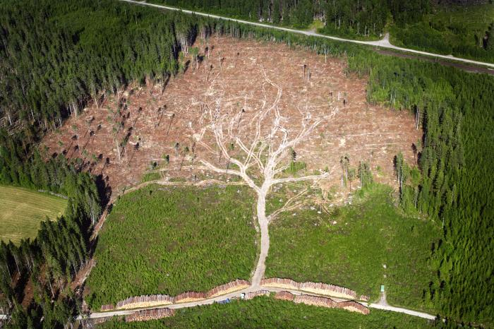
Nice, but what is in it for me?

Slide 27
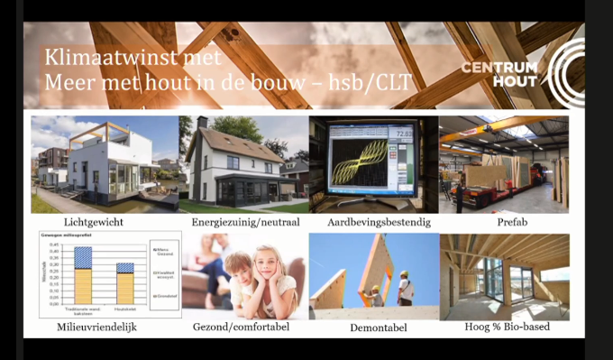
NTTA 21st century:
Century of wood

Slide 28
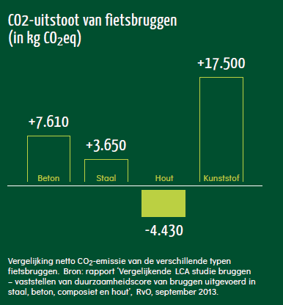
NTTA 21st century:
Century of wood
P&R and comms focus:
Biobased
Circular economy
CO2 (Zero Carbon)
Etc.
=> Verified sustainable pre-condition, for scoring well in LCA’s, EPDs etc!

Slide 29
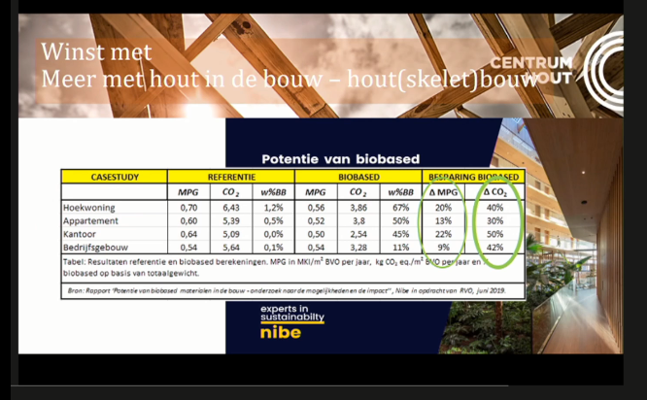
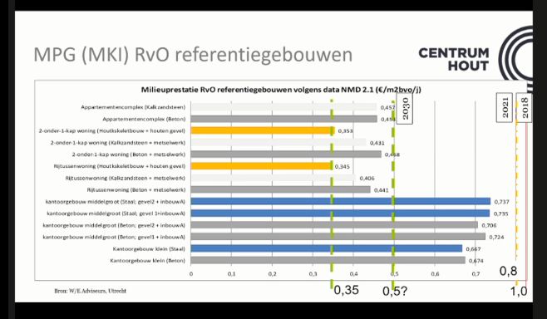

Slide 30
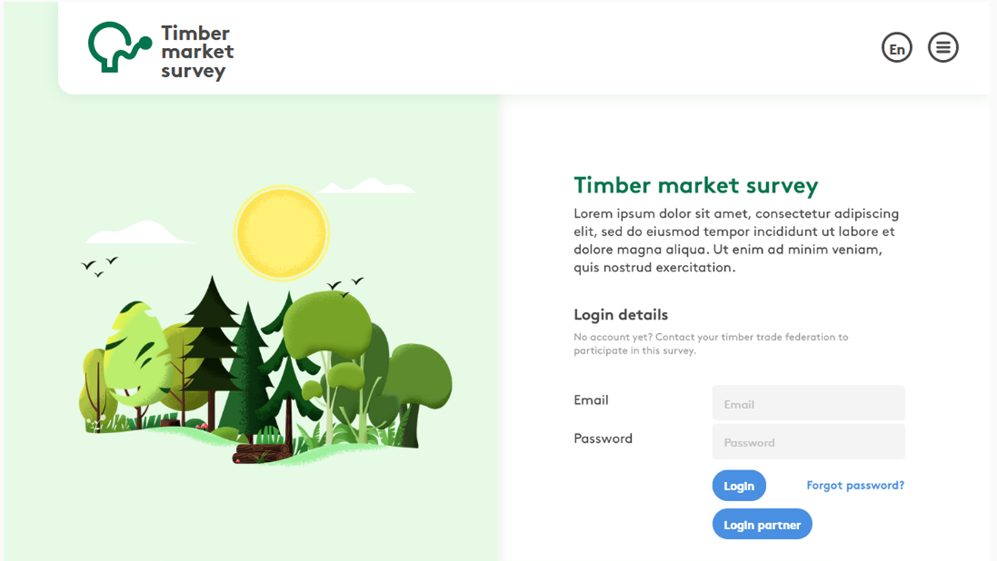
Monitoring crucial to support positive messaging
Trust in timber
Transparancy
Credibility

Slide 31
Thank you!
Questions?

Slide 32
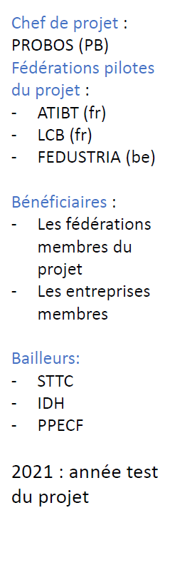
Présentation du portail Thémis
Démonstration :
https://framer.com/share/Timber-Market-Survey--aSyY67L1U1E66CvVLweD/htid80PFp#htid80PFp
Lien du portail :
timbermarketsurvey.com
« Thémis est un outil pour soutenir la gestion durable des forêts en introduisant, améliorant et vérifiant les progrès des politiques durables du bois des fédérations du commerce du bois dans les principaux pays consommateurs de bois en Europe. »

Slide 33
Project leader:
PROBOS
Pilot federations of the project :
ATIBT
LCB
Fedustria
Beneficiaries:
the project's member federations
member companies
Funders:
STTC
IDH
PPECF
2021: test year of the project
Presentation of the Themis portal
Demonstration:
https://framer.com/share/Timber-Market-Survey--aSyY67L1U1E66CvVLweD/htid80PFp#htid80PFp
Link to the portal:
timbermarketsurvey.com
"Themis is a tool to support sustainable forest management by introducing, improving and verifying the progress of sustainable timber policies of timber trade federations in the main timber consuming countries in Europe."

Slide 34
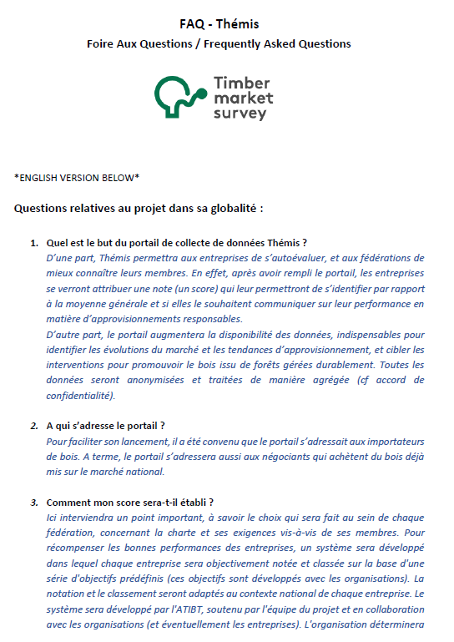
Pourquoi collecter des données?
Présentation du portail Thémis
Positionner le bois comme l'une des solutions pour contribuer à la lutte contre le changement climatique et promouvoir l’usage des produits en bois :
Clé de l'approvisionnement durable ;
Les objectifs permettent d'augmenter les ventes de produits certifiés et d'encourager la gestion durable des forêts
Les données des produits certifiés achetés sont un bon indicateur de performance (KPI)
Augmenter la transparence

Slide 35
Why collect data?
Presentation of the Themis portal
Position timber as one of the solutions to contribute to the fight against climate change and promote the use of timber products:
Key to sustainable procurement
Setting targets increases purchases of certified products and encourage sustainable forest management
Data on certified products purchases is a good key performance indicator (KPI)
Increase transparency

Slide 36
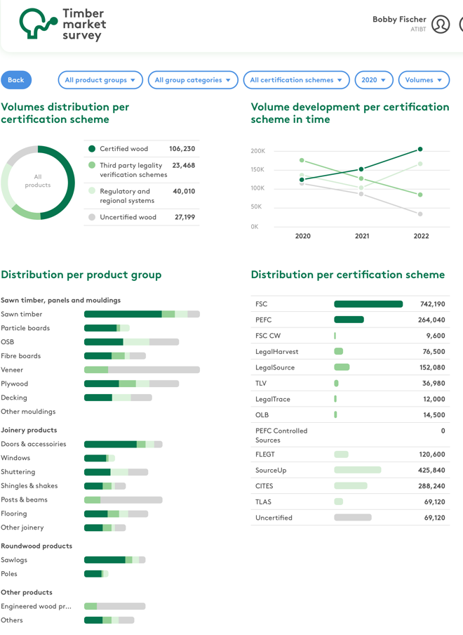
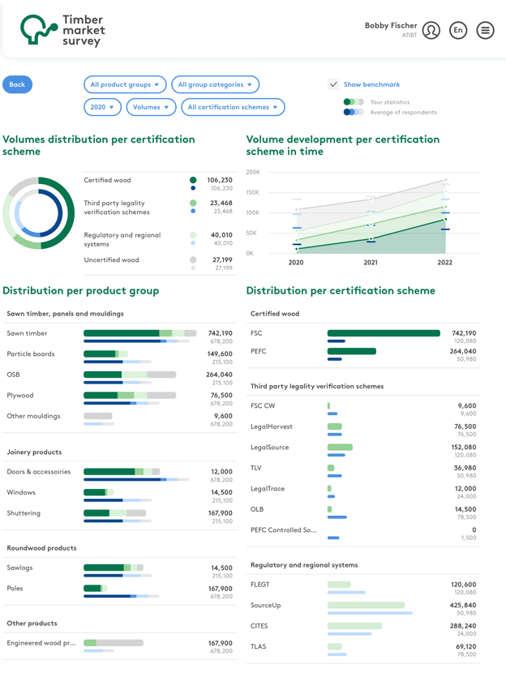
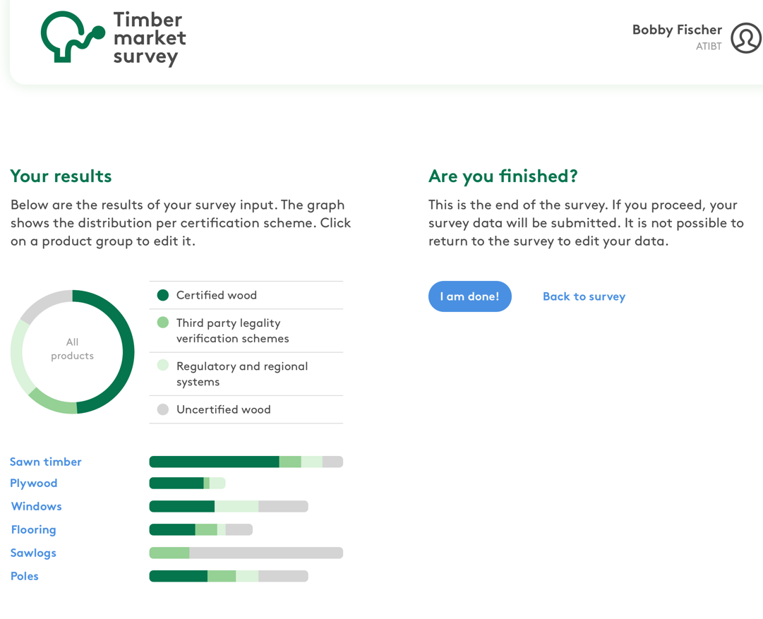
Les développements de l’outil
Présentation du portail Thémis

Slide 37
The development of the tool
Presentation of the Themis portal

Slide 38
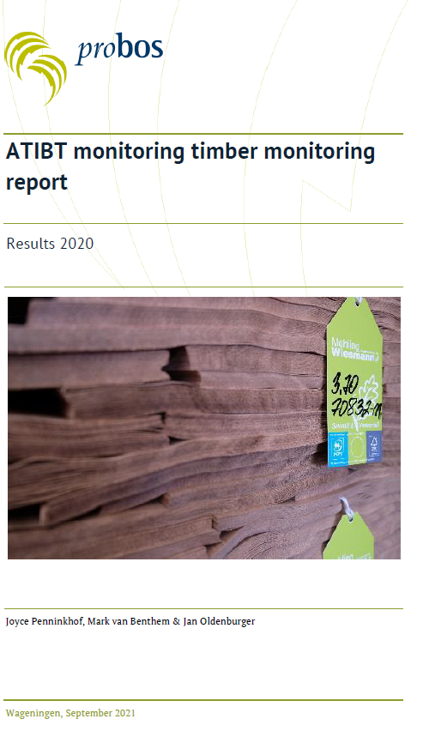
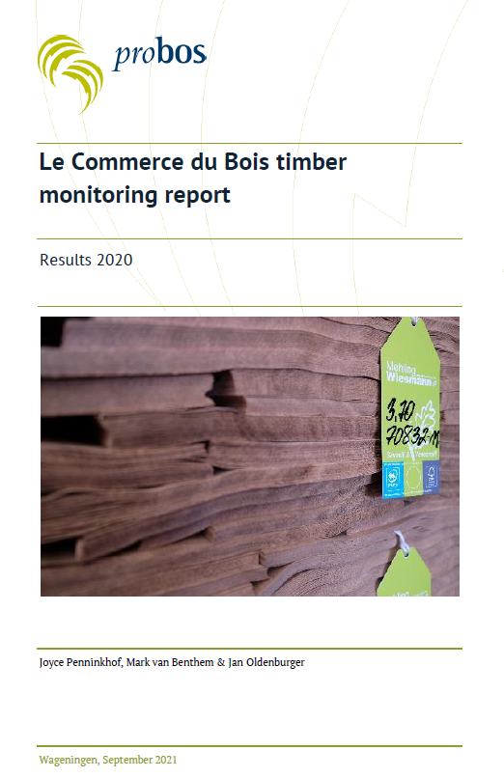
Q&A

Slide 39

Les liens entre l’outil Thémis et la charte environnementale

Slide 40
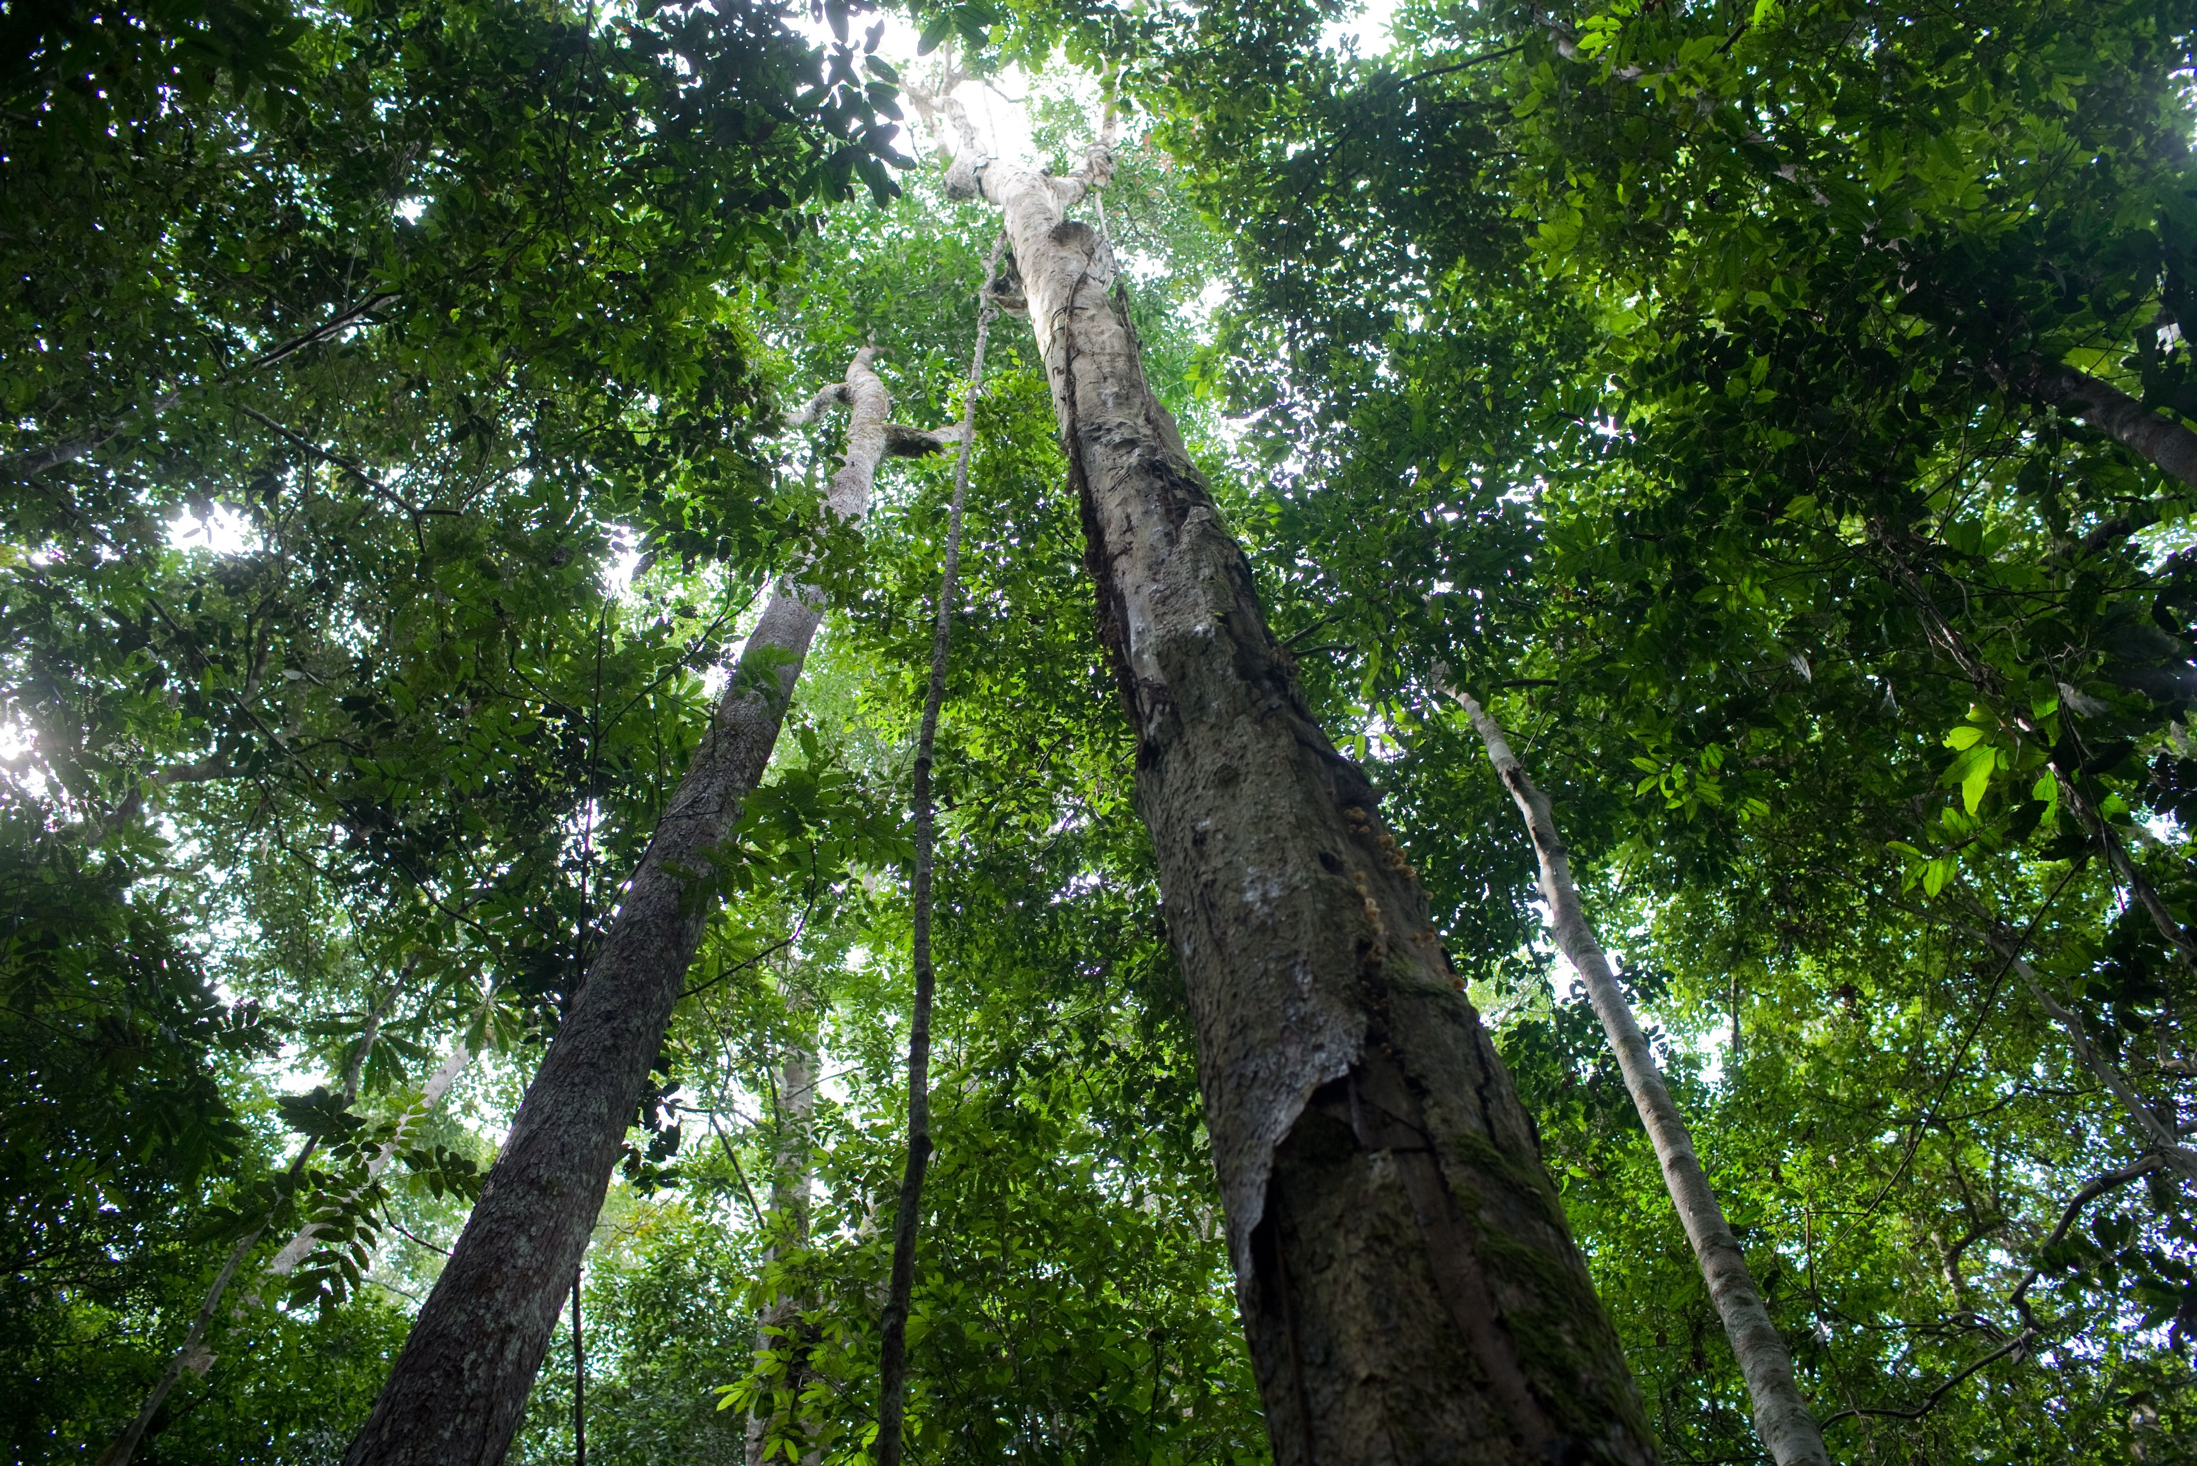
Merci pour votre attention!
Thank you for tour attention!
Merci pour votre attention !
Thank you for your attention!

