Slide 1


Legal and Deforestation Free System for US Hardwoods
Michael Snow, Executive Director
Rupert Oliver, Environmental Policy Director
American Hardwood Export Council
May 2024

Slide 2
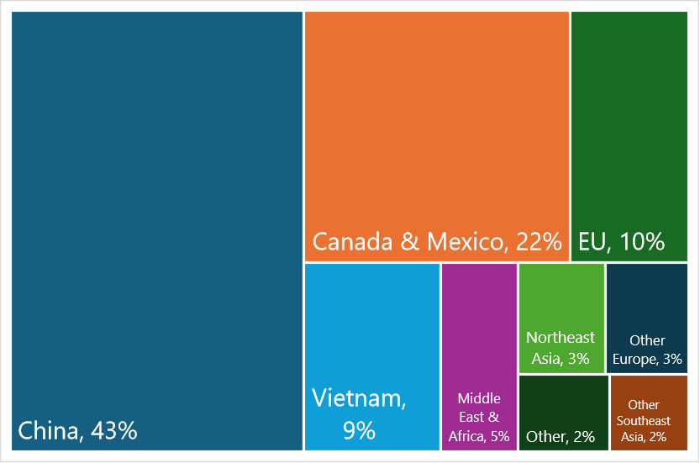
US hardwood log, lumber & veneer exports by market (US$ 2023)
Total value in 2023:
$2,735 million
Source: USDA GATS

Slide 3
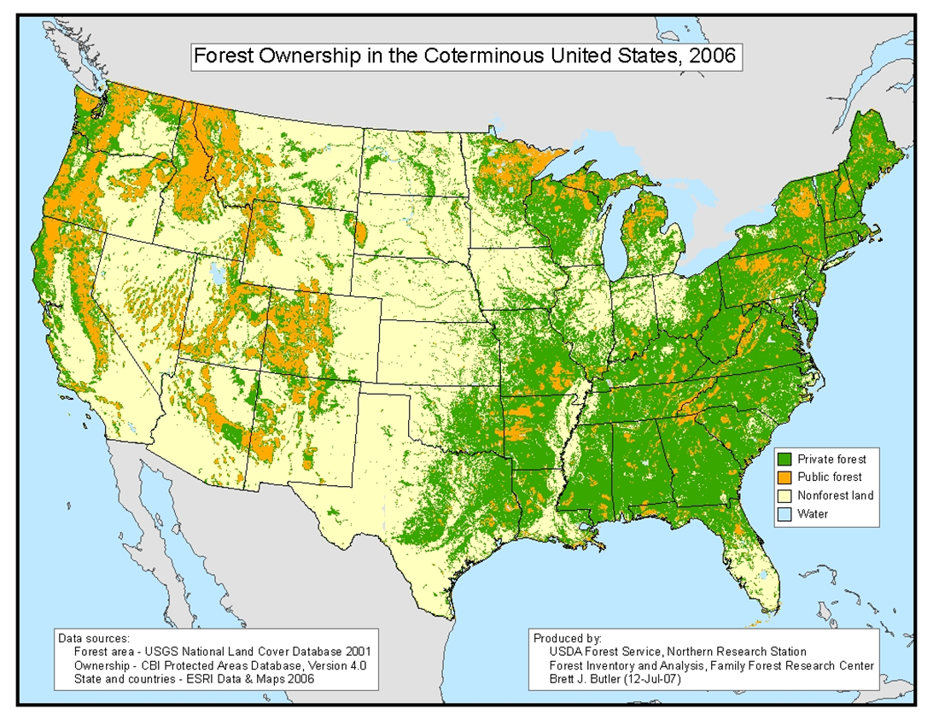

Slide 4
Diverse semi-natural forest, fragmented ownership, complex supply networks
Over 90% of American hardwood logs from private landowners
9.4 million small family forest owners, average holding < 10 hectares
USDA National Woodland Owner Survey: 22% identify ‘Timber’ as a reason for owning forest
Low intensity selection felling of diverse natural forest
Each harvest comprises small quantities of each species in variable grades
Sawmills source from 100s of landowners within 25-100 mile radius each year
Supplying consignments of specific species, grade, size, & color requires aggregating and mixing from numerous small harvest sites across numerous ownerships over a period of time

Slide 5
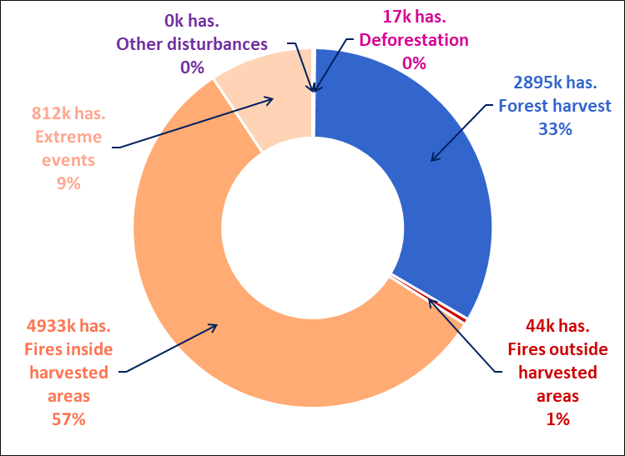
Commodity-driven deforestation risk close to zero in the US
U.S. forest disturbance, area by type of disturbance in 2022
U.S. deforestation as % of total disturbance & forest area
Source: EU Observatory on Deforestation & Forest Degradation,
EC Joint Research Centre (JRC)

Slide 6
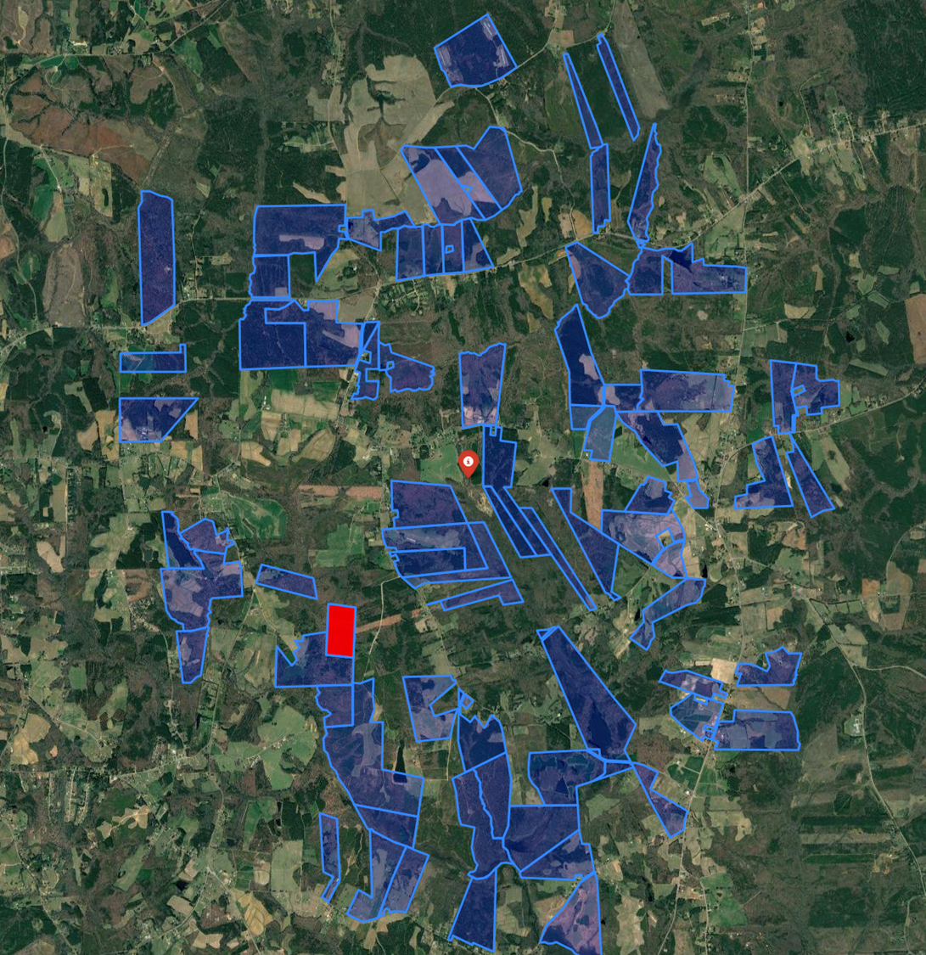
EUDR conformance framework for U.S. hardwoods
The system will enable all containers of U.S. hardwood arriving in the EU to be accompanied by the documentation required to demonstrate legal and deforestation-free origin, including geolocation data.
The system comprises the following components:
  an annually updated database identifying to an unprecedented level of accuracy all harvesting operations in U.S. hardwood forests which are not “deforestation-free” according to EUDR definitions.
  independent third-party assessments of the risk of illegal harvesting in each of the 33 U.S. hardwood producing states.
  an on-line application to make this data freely accessible to U.S. hardwood mills and other operators engaged in the export trade.
  an SHC chain of custody (CoC) standard for hardwood mills and downstream distributors, exporters, and manufacturers to ensure that the legal and deforestation-free claim is applied only to verified U.S. hardwood.

Slide 7
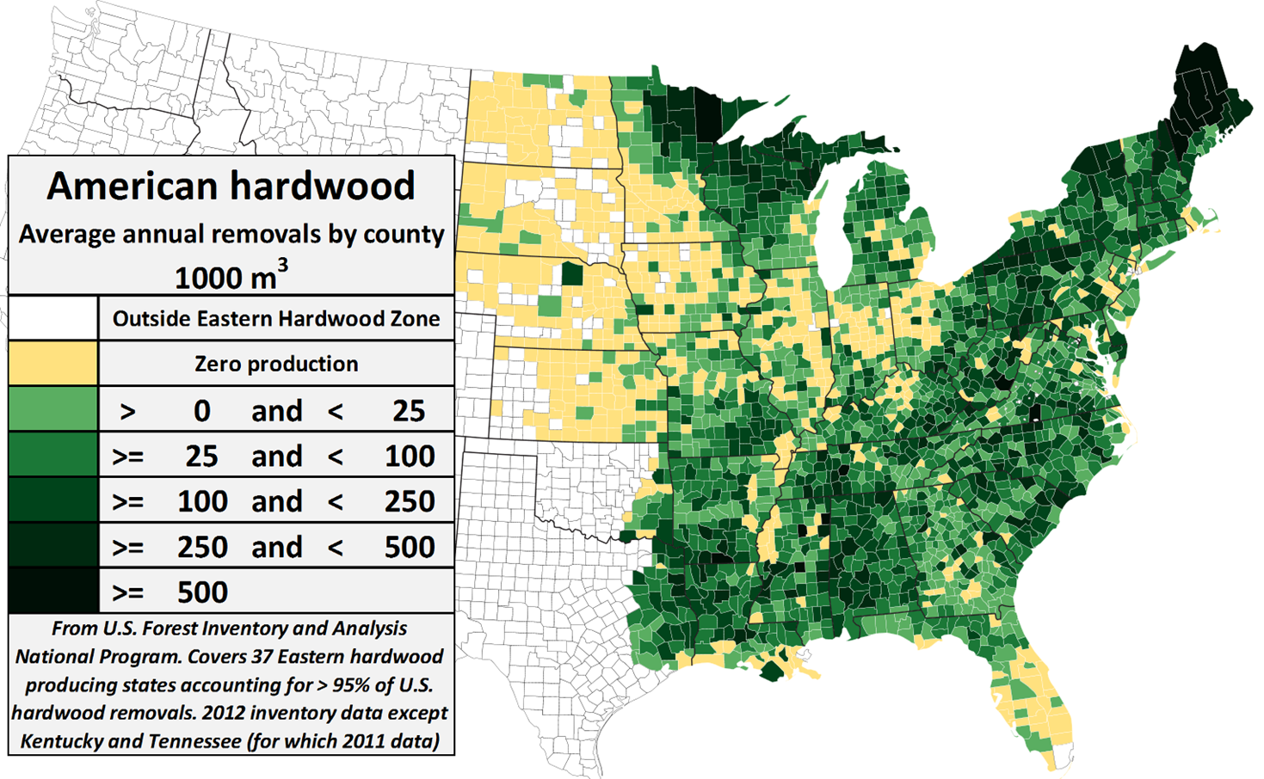
The aim is to enable US hardwood exporters to provide with every consignment delivered into the EU the geolocation comprising the polygons of supplying counties & the year of harvest
Regular analysis of satellites and other contextual data precisely quantifies deforestation risk at county level
Mills must take mitigation action to avoid sourcing from specific properties where there is EUDR deforestation risk
County level data is manageable - 1360 counties account for > 99% of hardwood supply (compared to 9.5m forest owners)
County level geolocations can be verified using plant-chemistry-based provenance technologies
County level geolocation avoids unnecessary costs & burdens on small operators where risks are negligible
Resolves confidentiality and anti-trust issues surrounding provision of data on individual properties

Slide 8
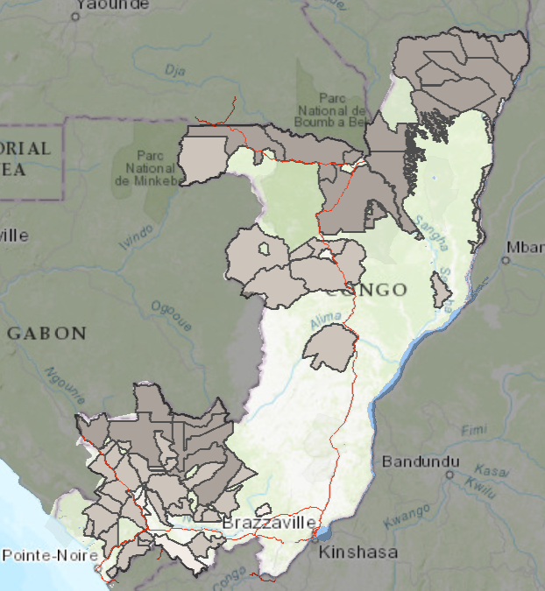
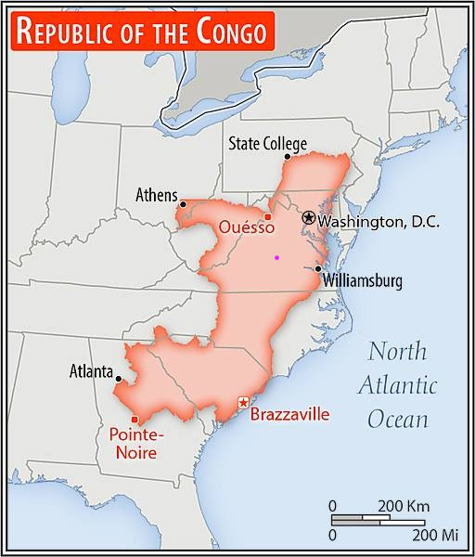
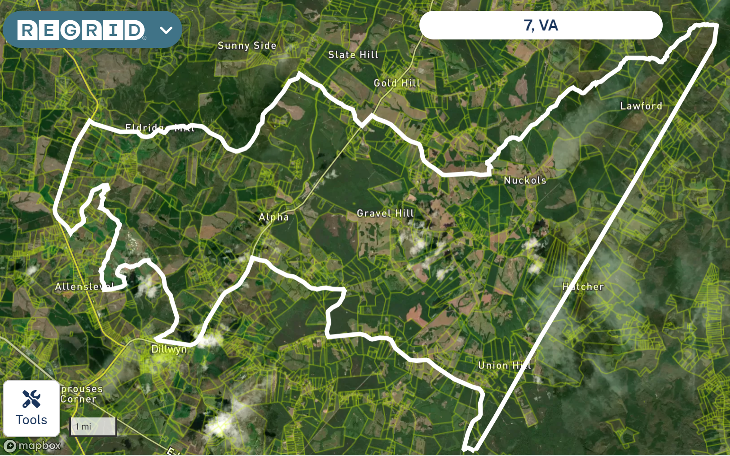
Providing county level geolocation data ensures equity between supplies from smallholder, industry and state lands
Buckingham County, Local District 7, Virginia, an area of 20k hectares, has more than 1000 real estate properties containing forests
Republic of Congo:
Country area: 34m hectares
State owns all production forest
Concession area: 15m hectares
Number of concessions: 62
Average concession:
240,000 hectares
US counties supplying hardwood average 160,000 hectares area & 100,000 m3 of hardwood log harvest per annum, equivalent to individual state or industry forest holdings in many countries

Slide 9
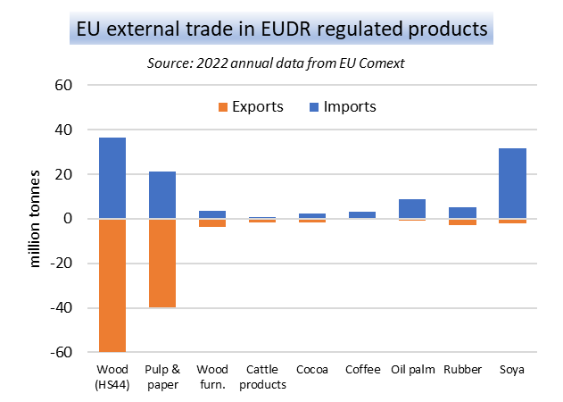
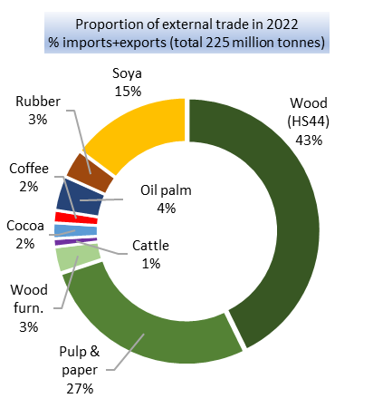
Wood based products account for 73% of all EU external trade volume in EUDR-regulated products, agricultural commodities for 27%

Slide 10
Thank you
AHEC Representatives:
Mike Snow, msnow@ahec.org
Rupert Oliver, rupert@americanhardwood.org
Robin Fisher, robin@americanhardwood.org

